Slide 1
MULTI – TOUCH ATTRIBUTION MODEL & MARKETING SPEND OPTIMIZATION

Slide 2
Business Objective:
Improve the advertising ROI by quantifying the true value of the multi-faceted advertising campaigns
Enable business stakeholders to take decisions based on the millions of converting click paths by isolating impact of every touch point

Slide 3











The Value of Multi-Touch Attribution
Advanced Attribution Provides Advertisers With More Transparency Into The Contribution Of Each Media Asset
LTA MTA
➢➢ 100% credit to last ➢➢ Full funnel credit view/click per channel digital channels
➢➢ Aggregate performance ➢➢ User-level behavior trends
➢➢ Deep-dive analytics
✓✓ Media sequencing
✓✓ Frequency management
✓✓ Viewability tracking
✓✓ Precision testing
✓✓ DSP bidding audits
Example User Path to Conversion:
Multi-touch attribution (MTA)
distributes credit across more than just the last exposure
Click to
Carrier
First Touch
First Click
Display
Search
Last Touch Last Touch/Click
Last-touch attribution (LTA) does not consider cross
channel interaction leading to duplication of conversions

Slide 4




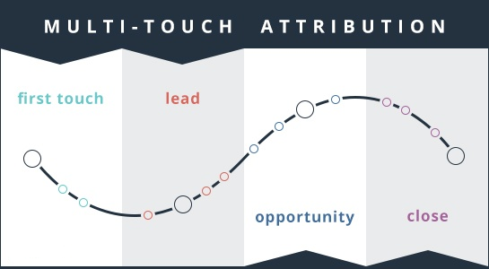
MTA Process Overview
Inputs
Data Modeling
Process
Innovate the HOW
First Touch Attribution
Linear Attribution
Time Decay
Position Based
Markov Chain
Create a model which incorporates the non-linear and dynamic advertising effects
Raw Data
Outlier treatment
Redundant impressions
Advantages
Low touches
Incomplete conversions
Measure Attributions
Measures the real impact of various brand marketing activities
Clean dataset
Granular Analysis
New age models built at various levels of marketing activities- user, creative, campaign, path, frequency
Data from various sources is processed before inflowing into the model
Tools used – Python/Spark
Intuitive Visualization
Enables business to visualize relationships between entities

Slide 5




Overview of MTA Modeling Inputs
Data Sources
Ad Serving
• DoubleClick impressions, clicks (display & search), and activity (CTC) log files
Ad Verification
• Integral Ad Science (IAS) user level cookie enablement for viewability measurement
Media Buy
Channels
• Includes standard and high impact units across Desktop Display, Mobile Display, and Video
• Requires a 3rd party vendor for cross-device mapping

Slide 6



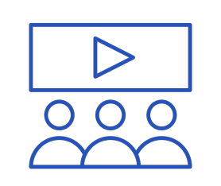


Deep – Dive Analysis
Precision Testing: Leverage the MTA results to run A/B and multivariate tests to reduce false positive conclusions and inflated partner rankings
Partner Bidding: Evaluating DSP delivery with attributed conversions helps analyze true partner performance, giving insight into bidding process to optimize spend
Frequency Management: Analyzing ad engagement and setting an exposure threshold to improve campaign performance and reduce over-spending
Viewability Tracking: Improved partner accountability and analysis by attributing only “Viewable” impressions
Media Sequencing: Identify top user paths to optimize sequencing along campaigns
Media Buying: Dayparting/Weekparting (timing campaigns) for key holidays and events to improve media efficiency by analyzing historical data

